Slide 1
MuleSoft Catalyst
Building on the concepts of identifying business outcomes, enabling the organization, and delivering technology.
MuleSoft Catalyst pillars are further broken into six paths for users to follow:
  Business outcomes
  Anypoint Platform
  Projects
  Center for Enablement (C4E)
  Internal support
  Training

Slide 2
Each path has been prepared into a rich playbook and containing best practices to accelerate customer success.
Each of these six playbooks, we follow a consistent approach to planning for success, establishing the foundation, building to scale, and measuring impact to ensure the customer is achieving the desired outcomes.

Slide 3
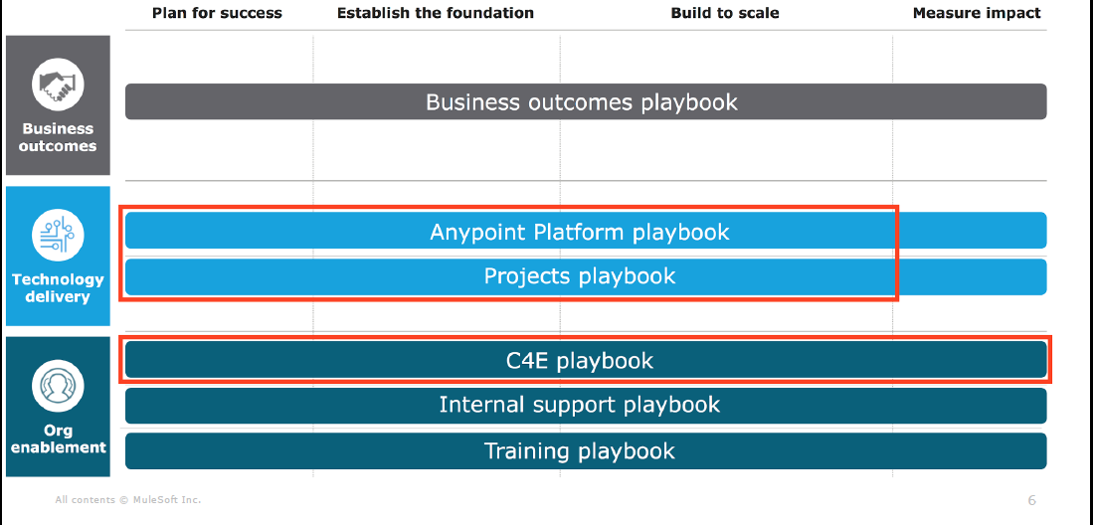
Six Paths to Follow

